Slide 1
Discussion on liberalization of trade in health services: is there any implication on health on ‘low-skilled’ migrants?
Rapeepong Suphanchaimat
IHPP
19 Nov 2019

Slide 2
Likely models
Cross border delivery (technology moves)
Consumption abroad (patients move)
Commercial presence (money moves)
Movement of natural persons (providers move)
Other models?

Slide 3
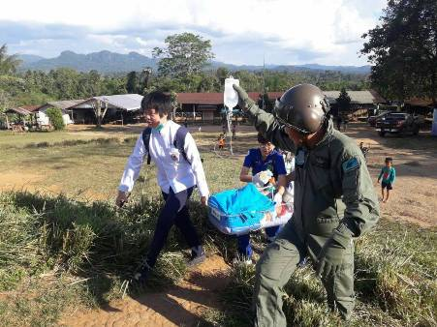
Model 1: Cross border delivery
Sister hospitals
Health posts along the border
Law permit?

Slide 4
Model 2: Consumption abroad (i)
Migrant patients move.
Pattern 1: People cross the border first to seek job prospects, then they become sick.
Pattern 2: People cross the border because of health reasons.
Private sector??
Health insurance policy = OK!
Health insurance policy = not OK! (but in the field this may be OK).

Slide 5
Model 2: Consumption abroad (ii)
Some challenges present, for instance, now there is a marked shift of the migrants’ work patterns. This raises a question whether and to what extent the existing healthcare system is ready for the shift.

Slide 6
Model 3: Commercial presence
$$$
Private facilities draw money from the rich foreign patients.
Then (some) rich foreign patients become poor.
Then (some) poor foreign patients move to public facilities.
Then (some) public facilities face financial debt (partly) from providing care to poor foreigners who lack ability to pay for their treatment.
Then (some) public facilities encountering financial debt try to raise money from foreign patients to subsidize cost of care.
The rise of cost of care (partly) discourages rich foreign patients to utilize public hospitals. So the rich are still likely to enjoy care at private facilities.

Slide 7
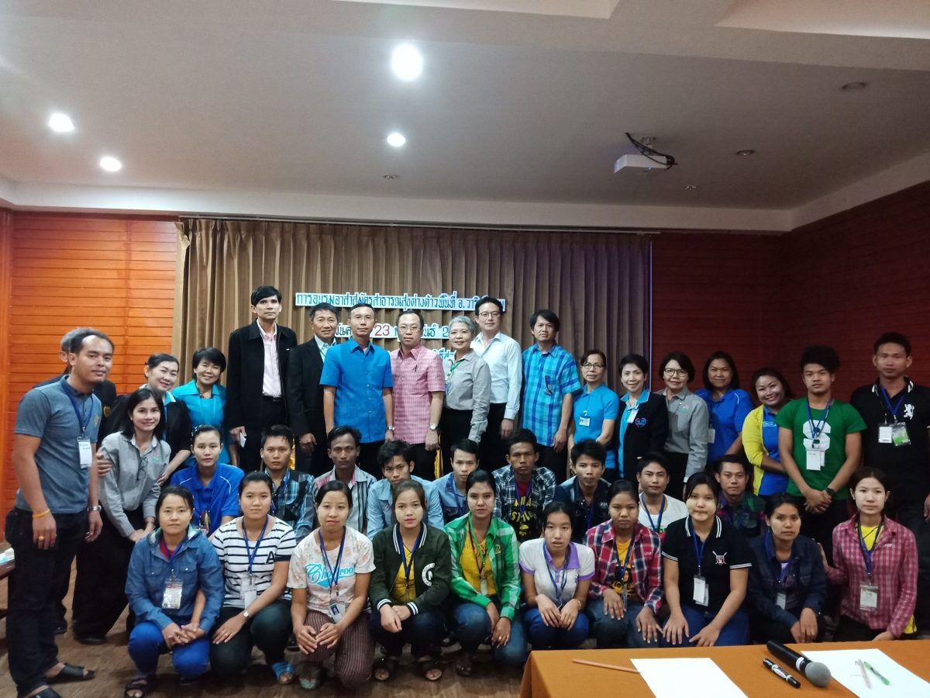
Model 4: Movement of natural persons
Mutual Recognition Agreements (MRA) focus on doctors, dentists, nurses, etc.
Why not other types of health workers?
Health interpreters in Malaysia
Migrant health volunteers in Thailand

Slide 8
Concluding remarks
Money is vital and the spirit of providers is of equal (or even more) importance.
Return of the investment from regional trade to take care the vulnerable needs to be explored further.
Devil is in the detail! Nice words are inspiring, but without legal and political support they may be just a daydream. At the other end, political support without knowledge is a nightmare.

Slide 9
THANK YOU

